Slide 1


TURKEY, CYPRUS, AND THE
EASTERN MEDITERRANEAN DILEMMA
Two engines of deadlock — and four ways out
Prof. Dr. Ozan Örmeci
Political Scientist · ESUPA President · www.esupa.org.tr
Notes:
Webinar presentation on the future of the Cyprus problem and possible scenarios in the Eastern Mediterranean.

Slide 2
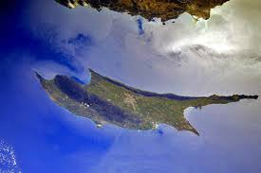
ROADMAP
How this talk is organised
1
The Eastern Mediterranean in one slide
Why this sea matters?
2
The Cyprus Conflict: The Essentials
1571 – 2017 in one timeline
3
Where we stand today?
Three states, one island — and a new window
4
Two Engines of Deadlock
The European track · The geoeconomic–security track
5
Four Scenarios
Status quo · Escalation · Partial agreement · Comprehensive settlement
2
Notes:
Announce the framework up front: background is compressed to three slides; the core of the talk is the two causal dynamics driving the deadlock, and the four scenarios that follow from them.

Slide 3
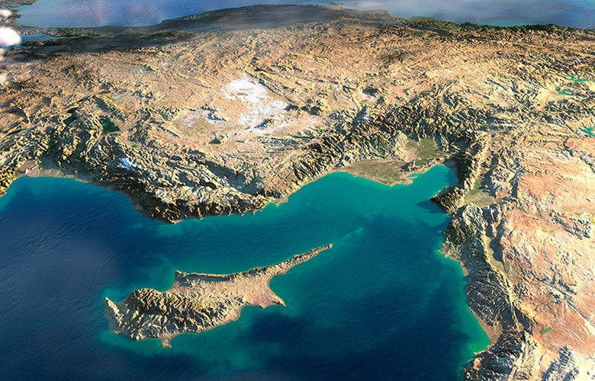
SETTING THE SCENE
1. The Eastern Mediterranean in one slide
An intercontinental crossroads: where Southeastern Europe, Western Asia, and Northeastern Africa converge.
A trade artery: waterways and chokepoints of the region — above all the Suez Canal — handle close to 30% of international maritime trade.
A conflict cluster: the Cyprus Conflict, the Israeli–Palestinian Conflict, Syria's wars, and overlapping maritime claims all sit in the same basin.
Littoral states: Turkey, Greece, Cyprus, Syria, Lebanon, Israel, Palestine, and Egypt — very different economies, one shared sea.
The Eastern Mediterranean basin
3
Notes:
Compressed from former slides 3–7. Detail for narration: the region hosts high-income (Israel, Cyprus, Greece, Turkey), middle-income (Lebanon) and low-income (Egypt, Palestine, Syria) economies; core logistics hubs include Ambarlı and Mersin (Turkey), Port Said and Alexandria (Egypt), Haifa (Israel) and Piraeus (Greece). The EM's direct share of global GDP is modest — its weight comes from controlling chokepoints and transshipment lanes between Eastern and Western markets.

Slide 4
SETTING THE SCENE
2. The Cyprus Conflict: The Essentials
Ottoman rule begins; Turkish population settles alongside Greek Orthodox community
Independent Republic of Cyprus — bi-communal partnership; UK, Turkey, Greece guarantors
Greek junta-backed coup for Enosis; Turkey intervenes as guarantor — island divided
Annan Plan: Turkish Cypriots vote yes, Greek Cypriots no; RoC joins the EU
1571
1960
1974
2004
1878
1963
1983
2017
Island leased to Britain; annexed in WWI, colony until 1960
Intercommunal violence; partnership state collapses, Turkish Cypriots leave parliament
TRNC declared in the north; recognised only by Ankara
Crans-Montana talks collapse — the closest approach to a federal settlement
4
Notes:
Compressed from former slides 8–11. Narration detail: Ottoman rule lasted over three centuries (1571–1878); the 1878 lease was in exchange for British support against Russia; the 1960 Republic emerged from UK–Turkey–Greece negotiations; systematic attacks against Turkish Cypriots began on 21 December 1963; in 1974 the EOKA-B junta overthrew Makarios seeking union with Greece (Enosis), triggering Turkey's two interventions in the summer of 1974, which gathered Turkish Cypriots in the north; since 1983 Ankara's primary objective has been the TRNC's survival and recognition.

Slide 5
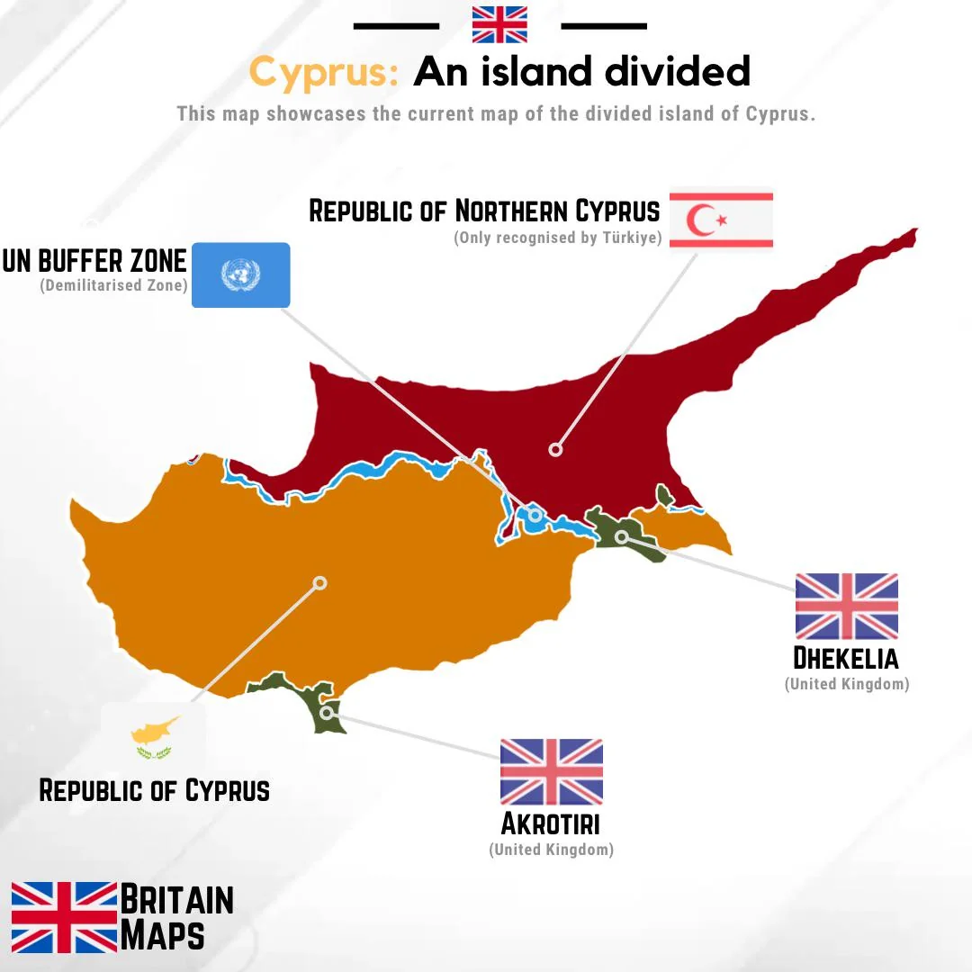
3. WHERE WE STAND TODAY
One island, three states, one buffer
59%
Republic of Cyprus (Greek Cypriot administration) — internationally recognised, EU member
36%
TRNC — self-declared in 1983, recognised only by Turkey
2.7%
UK Sovereign Base Areas: Akrotiri & Dhekelia
2.3%
UN-controlled buffer zone (the Green Line)
5
Notes:
Former slide 12. The status quo established in 1974 has proved remarkably durable — but it is precisely this map that every scenario in the final section proposes to keep, harden, or redraw.

Slide 6
3. WHERE WE STAND TODAY
A new window for negotiations?
IN THE NORTH
IN THE SOUTH
AT THE UN
Tufan Erhürman
Nikos Christodoulides
María Ángela Holguín
Newly elected Turkish Cypriot leader — a pro-federal social democrat, re-energising the northern side of the table.
Greek Cypriot leader who also declares support for a federal solution — a rare moment of nominal alignment.
The UN Secretary-General’s Cyprus Envoy has been canvassing all parties; her consultations sketch a credible blueprint for next steps.
Bottom line: UN-sponsored negotiations could resume as early as this summer — the first genuine opening since Crans-Montana.
6
Notes:
Former slide 13. This window is the hook for the whole talk: whether it opens or closes depends on the two dynamics analysed next — and each scenario in the final section is essentially a different answer to what happens to this window.

Slide 7
4. TWO ENGINES OF DEADLOCK
ENGINE 1 · THE EUROPEAN TRACK
The EU as an asymmetry machine
In 2004, the Republic of Cyprus joined the EU as the legal representative of the whole island. Two decades on, the gap between the two communities has widened on every dimension:
2003
2026
GDP per capita (south)
≈ $20,000
≈ $40,000
Embassies worldwide
38
≈ 50
Position in Brussels
Candidate’s neighbour
Member with veto over Turkey’s accession
Turkish Cypriots
Isolated
More isolated — outside EU law’s application
Membership converted a bilateral dispute into an internal EU problem — with only one side holding the pen.
7
Notes:
Former slide 15. Figures to verify against latest IMF/WEO data before the webinar — the original deck cited $45,000 GDP per capita for 2026, which looks high; ~$38–41,000 is the safer range. Embassy count: 38 in 2003, around 50 today.

Slide 8
4. TWO ENGINES OF DEADLOCK
ENGINE 1 · THE EUROPEAN TRACK
…which froze Turkey's European path
Nicosia’s veto leverage inside the EU meets Turkey’s stalled accession: each blocks the other, and the Cyprus Conflict migrates from the island to Brussels.
Ankara’s drift toward a more centralised, less democratic model and Brussels’ lack of will to enlarge reinforce the freeze from both directions.
A national cause becomes a geopolitical instrument: actors hostile to Turkey–EU convergence — and to NATO/EU cohesion against Russia, Iran, and China — benefit from keeping the problem alive.
Result: the EU dimension is simultaneously a cause of the deadlock and its casualty.
The point of Engine 1: EU asymmetry → Turkey–EU rift → less trust available for any Cyprus settlement.
8
Notes:
Former slide 18, reframed as the causal continuation of slide 7. For the webinar audience: phrase the democracy point as an assessment of mutual perceptions, not advocacy.

Slide 9
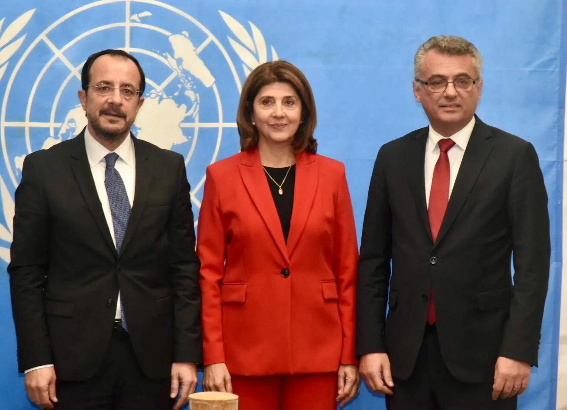
4. TWO ENGINES OF DEADLOCK
ENGINE 2 · THE GEOECONOMIC–SECURITY TRACK
Gas redraws the map
Major gas discoveries since 2009: Zohr (Egypt), Leviathan & Tamar (Israel), Aphrodite (Cyprus), Karish & Tanin (Israel).
The East Mediterranean Gas Forum (EMGF): Cyprus, Egypt, France, Greece, Israel, Italy, Jordan, and Palestine — the state with the longest EM coastline, Turkey, is not a member.
The EastMed pipeline, conceived to carry gas to Europe while bypassing Turkey, was shelved as too costly — commercial logic points back to cooperation with Ankara.
Energy did not create the disputes; it monetised them — and gave exclusion an infrastructure.
Christodoulides-Holguín-Erhürman
9
Notes:
Former slides 16–17. Narration: overlapping Turkish–Greek and Turkish–Cypriot claims over maritime and exclusive economic zones remain the core legal dispute; safe transport of hydrocarbons to Western markets is impossible without a modus vivendi that includes Turkey.

Slide 10
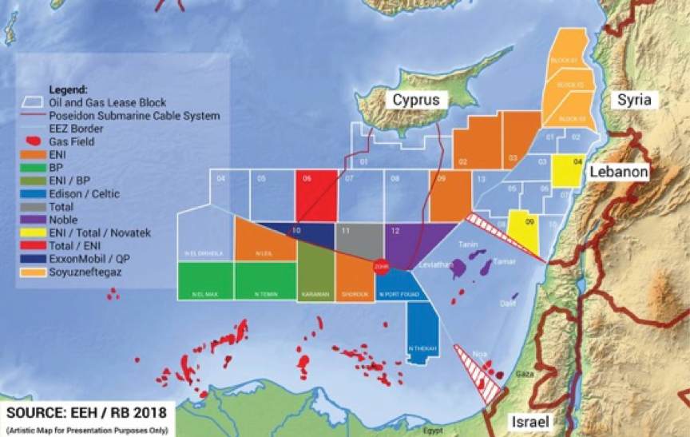
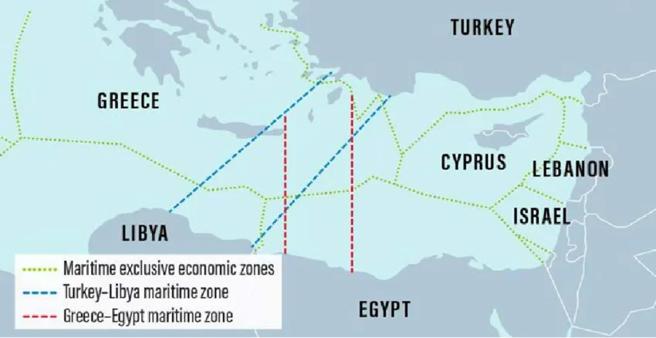
4. TWO ENGINES OF DEADLOCK
ENGINE 2 · THE GEOECONOMIC–SECURITY TRACK
…which hardened into rival blocs
Energy cooperation between Greece, Cyprus, and Israel escalated into joint military exercises and defence agreements.
France acquired base access in southern Cyprus (SOFA) — a first since 1960 and contested by Ankara as contrary to the founding treaties.
Washington engages selectively: formally balanced and pro-UN process, consistently supportive of Israel.
Turkey’s answer: the maritime memorandum with Libya and the "Blue Homeland" doctrine — alignment with the TRNC and Tripoli.
Exclusion from the gas forum and encirclement by the trio are the same process at two stages.
10
Notes:
Former slides 17, 19–20 merged. The two maps show the competing maritime visions: Greek–Cypriot claims (top) versus Turkey's continental-shelf claims and the Turkey–Libya delimitation (bottom). Mention the 2020 Courbet incident with France here as foreshadowing for Scenario B.

Slide 11
4. TWO ENGINES OF DEADLOCK
SYNTHESIS
Two engines, one deadlock
One engine runs through Brussels. The other runs through the seabed. They lock each other in place.
EU asymmetry
(2004 accession)
Turkey–EU rift
THE CYPRUS
DEADLOCK
Energy exclusion
(EMGF, EastMed)
Rival blocs
(Trio + France vs. Ankara)
…and the deadlock feeds both engines back: no settlement → no Turkey–EU thaw, no maritime delimitation → blocs persist.
11
Notes:
New synthesis slide. Spoken line: 'Two engines drive this conflict today — one runs through Brussels, one runs through the seabed — and they lock each other in place.' Each scenario that follows is an answer to the question: which chain gets unwound first? Scenario C unwinds the energy/security chain; Scenario D unwinds both.

Slide 12
5. SCENARIOS
A
Continuation of the status quo
BASELINE
All sides prefer known risks to unknown ones. Turkey — lonelier in the region but militarily strongest among coastal actors — keeps the TRNC alive without further damaging ties with the West; caution has always been a strong tendency in Turkish foreign policy.
DRIVERS
INDICATORS TO WATCH
Risk aversion of all littoral states
No cost to inaction for the trio
Ankara’s priority: TRNC survival, not escalation
UN talks fail to resume or stall quickly
No movement on Turkish–Israeli normalisation
EMGF continues without outreach to Ankara
Assessment: the default outcome — but growing trio–France cooperation suggests this equilibrium may not be permanent.
12
Notes:
Former slide 21 (first half). Structure of all four scenario slides is identical: description, drivers, observable indicators, likelihood assessment — this is what turns scenarios from speculation into analysis.

Slide 13
5.SCENARIOS
B
Escalation between Turkey and the trio
LEAST LIKELY
Polemics between Turkey and Israel, plus a possible Turkish rejection of a new Cyprus peace plan, spiral into provoked maritime incidents — the 2020 Courbet incident with France as the template — with the trio seeking US and French backing to corner Ankara.
DRIVERS
INDICATORS TO WATCH
Turkey–Israel polemics harden
Collapse and blame game over a peace plan
Maritime brinkmanship (NAVTEX wars, survey vessels)
Naval deployments around disputed blocks
New incidents at sea involving France or Israel
Suspension of Turkey–Greece exploratory talks
Assessment: least likely — Israel and the U.S. are absorbed by other priorities (Iran, Hamas), and Turkey's deterrent power makes conflict irrational from a Western perspective.
13
Notes:
Former slide 21 (second half). Keep the Courbet incident story for narration: June 2020, French frigate Courbet and Turkish vessels, a NATO-internal crisis.

Slide 14
5. SCENARIOS
C
Partial agreement on energy & maritime issues
MOST PLAUSIBLE
With EU and U.S. encouragement, coastal states reach a working consensus on safe transport of hydrocarbons to Western markets — growing economic cooperation between Ankara, Nicosia, Athens, and West Jerusalem — without anyone renouncing their national cause.
DRIVERS
INDICATORS TO WATCH
Commercial logic: no viable export route bypasses Turkey
EU/U.S. interest in de-escalation and energy security
Precedent: Israel–Lebanon maritime deal (2022)
Steps toward Turkish–Israeli normalisation (the prerequisite)
Technical talks on delimitation or energy transit
Ankara invited to any EMGF-adjacent format
Assessment: the most realistic path — it removes the risk of conflict while letting every actor keep its flag planted.
14
Notes:
Former slide 22 (first half). This scenario unwinds Engine 2 (the geoeconomic–security chain) while leaving Engine 1 intact — useful to say explicitly, referring back to the synthesis slide.

Slide 15
5. SCENARIOS
D
Comprehensive settlement
IDEAL, HARDEST
A package deal: a Cyprus settlement reunifying Europe’s last divided capital, alongside Turkey’s inclusion in the EU’s SAFE programme, Schengen visa liberalisation for Turkish citizens, and a modernised Customs Union extended to services.
DRIVERS
INDICATORS TO WATCH
A genuine settlement window (Erhürman–Christodoulides)
EU strategic interest in anchoring Turkey
Package logic: linkage makes each element easier to sell
Actual resumption and progress of UN-sponsored talks
Concrete SAFE / Customs Union decisions in Brussels
Democratic and rule-of-law signals from Ankara
Assessment: the ideal end-state — blocked for now by skeptics and ultranationalists on all sides, and contingent on Turkey's return toward the rule of law.
15
Notes:
Former slide 22 (second half). This scenario unwinds both engines at once — which is exactly why it is the hardest: it requires simultaneous movement in Brussels, Ankara, Nicosia and both parts of the island.

Slide 16
CONCLUSION
The bottom line
The Eastern Mediterranean will remain a focal point of geopolitics: a subsystem where military, economic and political priorities of regional and global powers intersect.
Ankara’s stated position is readiness to cooperate with all regional actors within international law and the realities on the ground.
A partial energy–maritime agreement (Scenario C) is the least risky path available today.
A comprehensive settlement (Scenario D) should remain the horizon — the only scenario that switches off both engines of the deadlock.
Prof. Dr. Ozan Örmeci
www.ozanormeci.com · politikaakademisi.org · www.esupa.org.tr · ozanormeci@gmail.com
16
Notes:
Former slides 24 and 26 merged. Note the reframing: 'Ankara's stated position is…' — an assessment rather than advocacy, appropriate for an international webinar audience.

Slide 17
BACKUP
References
Örmeci, O. & Kısacık, S. (2019), "2002-2017 Döneminde Kıbrıs Sorunu ve Türk Dış Politikası: Gordion Düğümü Henüz Çözülemedi", in Türk Dış Politikası 2000'li Yıllar (eds. S. Kekevi & Ö. Kurtbağ), Ankara: Berikan, pp. 47-116.
Örmeci, O. & Kısacık, S. (2020), "Cutting the Gordian Knot: Turkish Foreign Policy Towards Cyprus During AK Party Era (2002-2020)", Studia i Analizy Nauk o Polityce, no. 1, pp. 21-64.
Örmeci, O. (2026), "How Ready Are Turkish Cypriots for EU Membership?", UPA Strategic Affairs, Vol. 7, no. 1, pp. 231-265.
Örmeci, O. (2026), Uluslararası Siyasetin Merkezinde Kıbrıs, Bursa: Sayda Kitap.
Şahin, D. (2024), "Power Plays in the Eastern Mediterranean and the Decline of US-Turkey Relations", Middle East Policy, 31, pp. 125-139.
T.C. Dışişleri Bakanlığı, "Kıbrıs", Accessed 04.07.2026, https://www.mfa.gov.tr/kibris.tr.mfa.
Tziampiris, A. (2019), "The New Eastern Mediterranean as a Regional Subsystem", in The New Eastern Mediterranean (eds. S. N. Litsas & A. Tziampiris), Cham: Springer, pp. 1-30.
Yorulmaz, M., Kısacık, S. & Helvacıköylü, G. (2022), "Rivalry in the new geopolitics of the Mediterranean", Anemon Muş Alparslan Üniversitesi Sosyal Bilimler Dergisi, 10(1), pp. 417-431.
17

